Slide 1

Design Patterns in Visual Studio Code Explorer
Alvia Siraj
and
Soodeh Vanaki

Slide 2

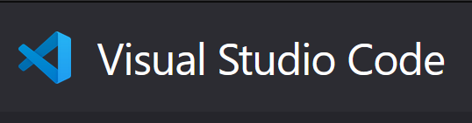
Introduction:
Lightweight but powerful source code editor
Available for Windows, macOS and Linux
Built-in support for JavaScript, TypeScript and Node.js
Rich ecosystem of extensions for other languages
Intelligent Code Completion
Streamlined Debugging
Fast, Powerful Editing
Code Navigation and Refactoring
In-Product Source Control

Slide 3
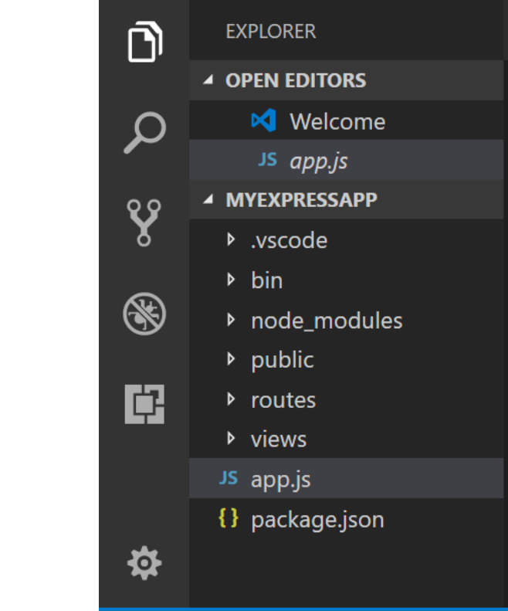
Research Question
Which design patterns were used in the implementation of the explorer tools, and how would one go about adding a tool using the respective design patterns?

Slide 4
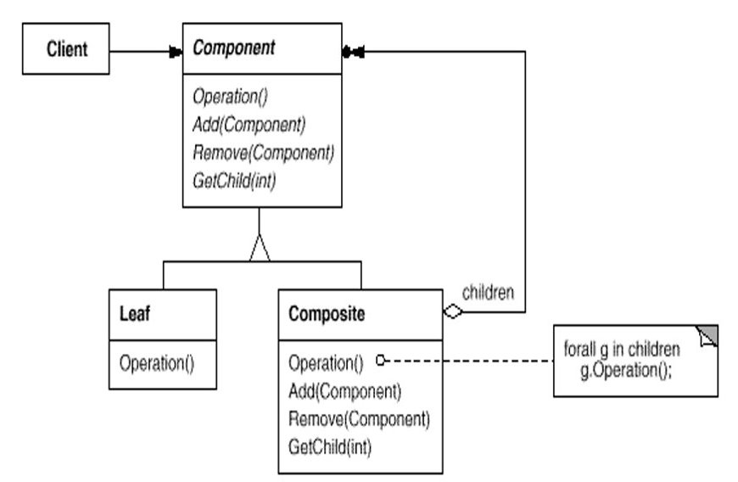
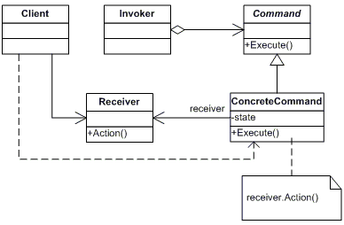
Design Patterns
Composite
Command

Slide 5
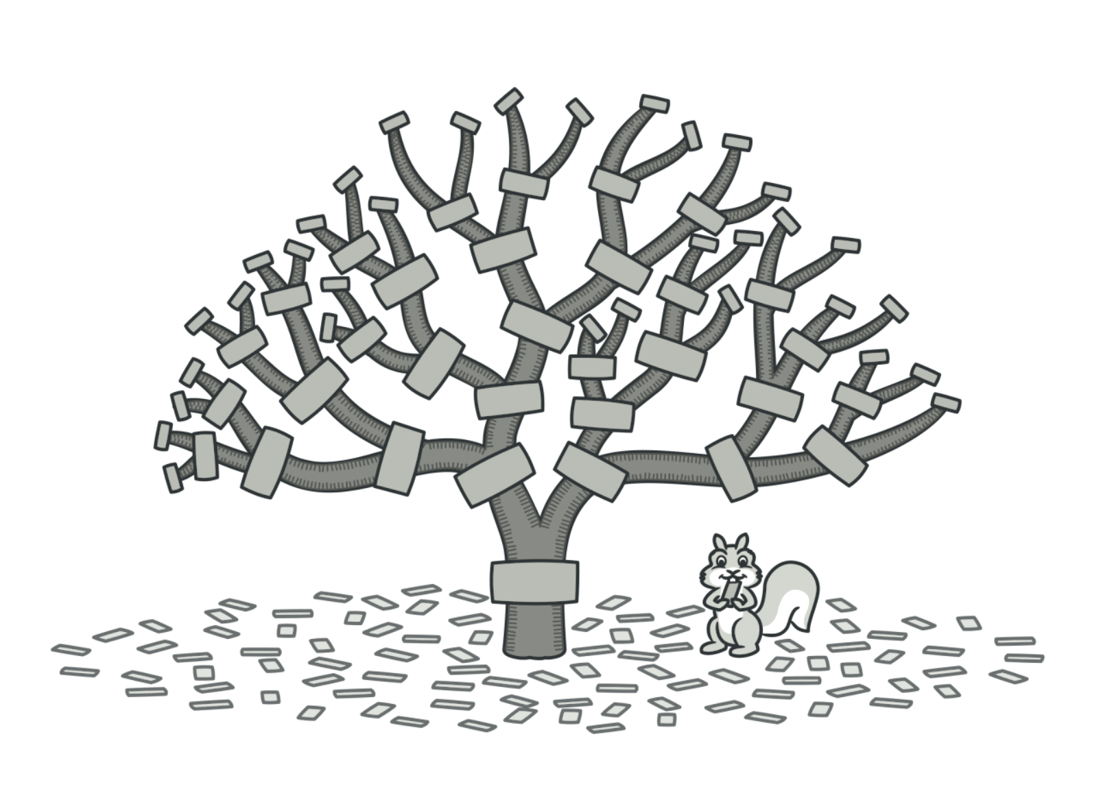
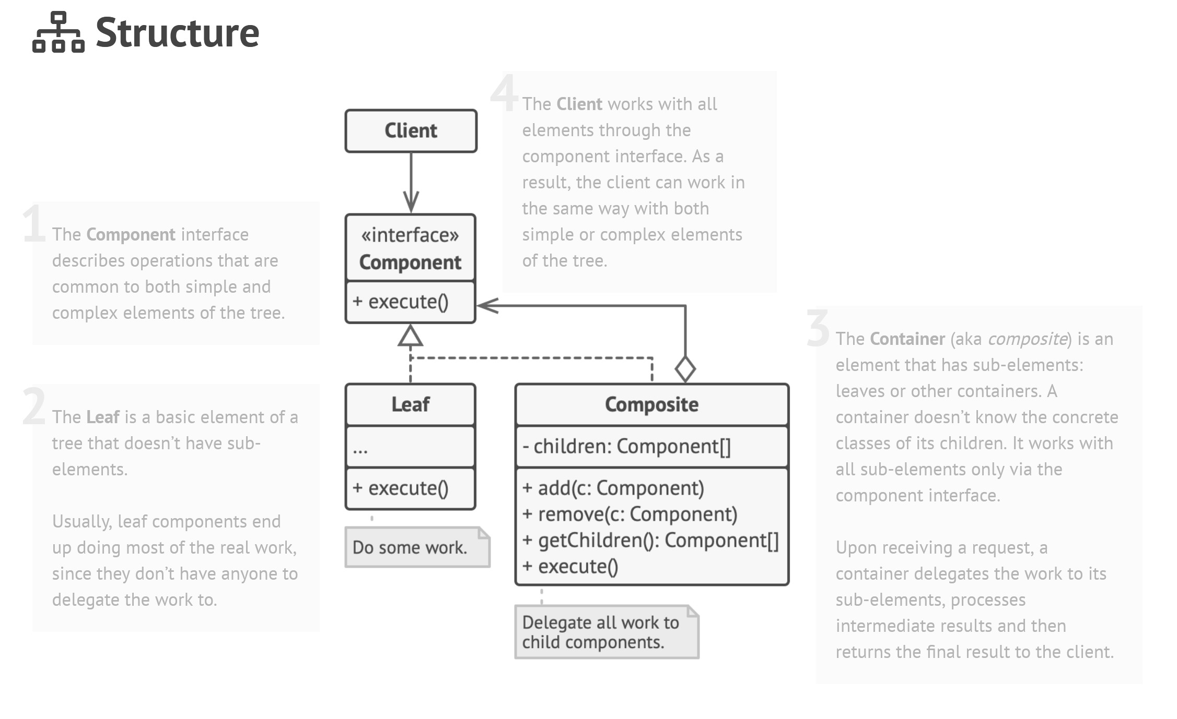
Composite Pattern

Slide 6
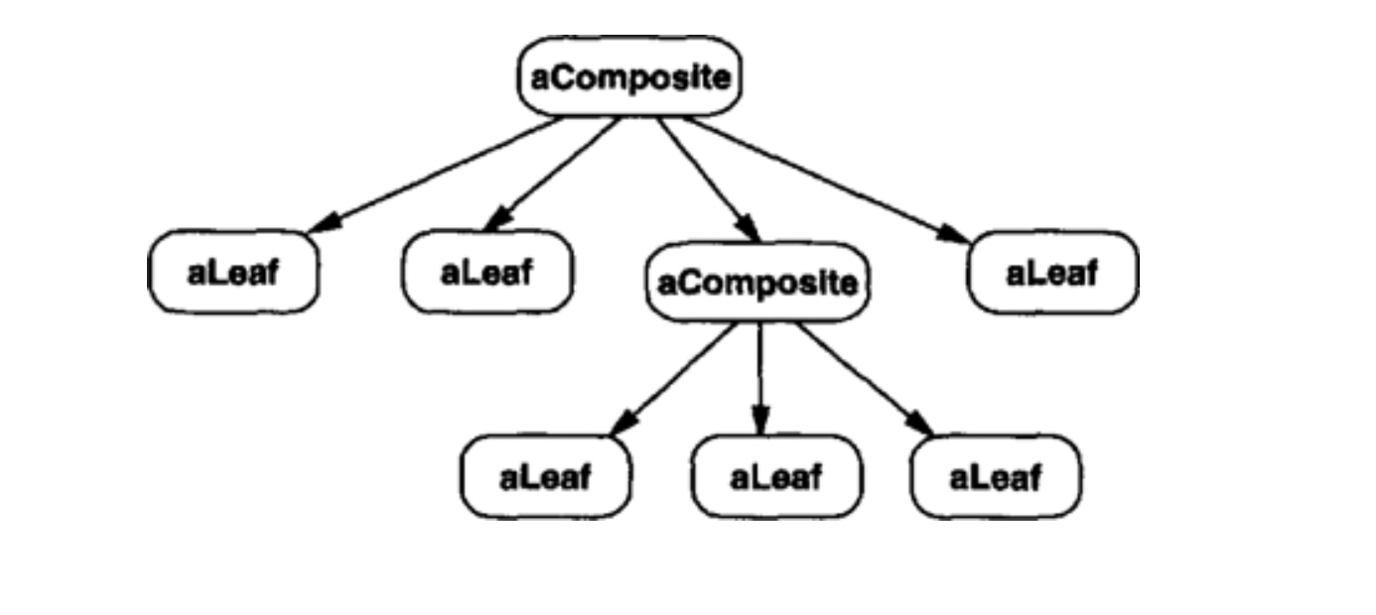
Composite Pattern
https://github.com/microsoft/vscode/blob/3aca77c01618839353d4360e72c1cac971276621/src/vs/workbench/contrib/files/browser/views/explorerView.ts#L133

Slide 7
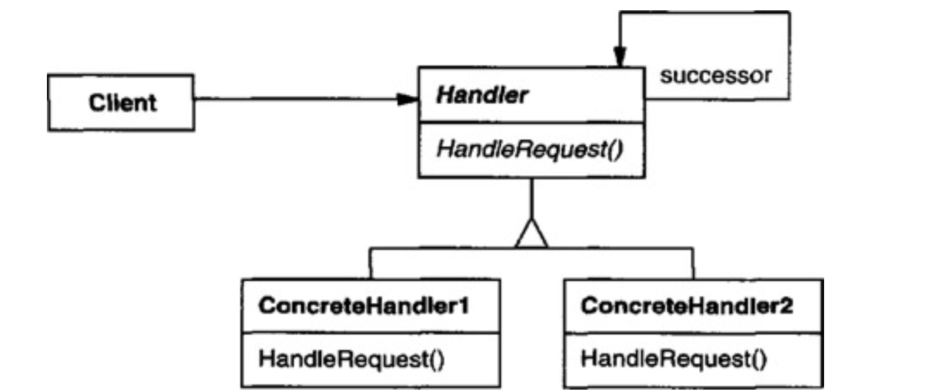
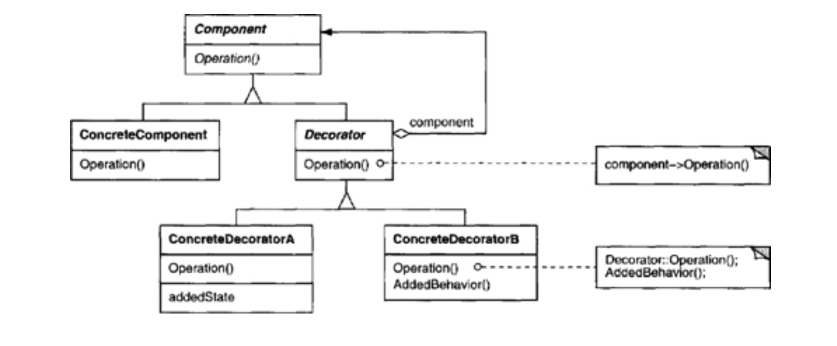
Related Patterns
Chain of Responsibility
Decorator

Slide 8
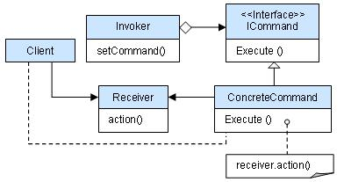
Command Patterns
Useful for test after test/ task after task operations.
Works well for toolkit objects
Consist of an abstract command class, Concrete command subclasses, a client, an invoker, and a reciever.
Parameterize objects by an action to perform
Each tool in the explorer
command patterns are used to trigger actions.
Specifies, queues and executes different tool requests at different times.
Supports changes

Slide 9
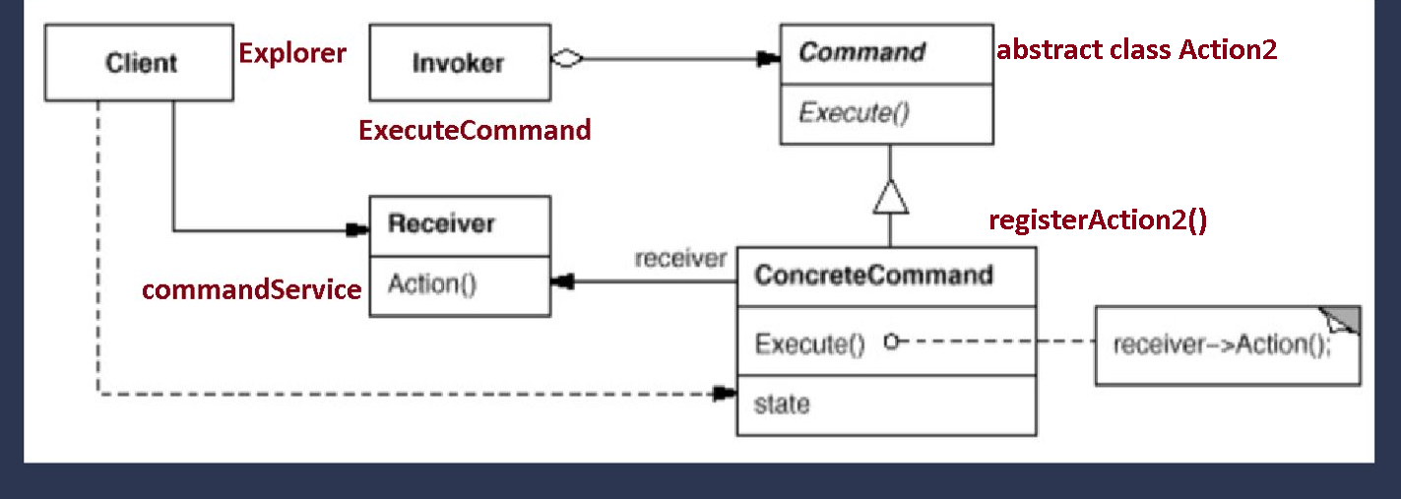
Command Pattern
https://github.com/microsoft/vscode/blob/3aca77c01618839353d4360e72c1cac971276621/src/vs/workbench/contrib/files/browser/views/explorerView.ts#L859

Slide 10
How would one go about adding a tool in the explorer using command?
Follow similar implementation structure as the other tools
Creating a new object using registerAction2 that extends Action2.
Constructor would create an id, a title, set f1 to true if it is an event, false otherwise, set icon, and menu
Create an object that inherits from the interface ICommandService
call executeCommand to execute the command

Slide 11
Conclusion
Browse, open, and manage all the files and folders
Create, delete, and rename files and folders
Move files and folders with drag and drop
Use the context menu to explore all options

Slide 12
Works Cited
“Commands.” RSS, Microsoft, 14 Apr. 2016, code.visualstudio.com/api/extension-guides/command.
Composite. refactoring.guru/design-patterns/composite.
“Composite.” Dofactory, www.dofactory.com/net/composite-design-pattern.
Doglio, Fernando. “5 TypeScript Design Patterns You Should Know.” Bits and Pieces, 2020, blog.bitsrc.io/design-patterns-in-typescript-e9f84de40449 .
Gamma, Erich, and Erich. Gamma. Design Patterns : Elements of Reusable Object-Oriented Software . 37th printing., Addison-Wesley, 1995.
Vane, Vilic. TypeScript Design Patterns: Boost Your Development Efficiency by Learning about Design Patterns in Typescript. Packt Publishing, 2016.

